Slide 1
3D animation face modeling and feature extraction based on computer graphics and image technology
Exploring Computer Graphics and Face Modeling Technology
Subject: Computer Graphics
Student Name: Hyder Presswala
Roll No.: 16010122151
Faculty Name: Mr. Vaibhav Vasani

Slide 2
01
Learning Outcomes
Table of Contents
02
Introduction
03
Creating Realistic 3D Animated Facial Models
04
Graphics foundation of 3D animation face
05
Preparation Process of Face Model Based on CG
06
Feature Extraction Algorithm of Animation Face Model Based on Computer Image Processing Technology
07
The final process of 3D animation face modeling based on computer graphics and image processing technology
08
Summary
09
References
10
Thank You

Slide 3
1
Learning Outcomes
Understanding of 3D Vision Technology:- We will learn the foundational principles and significance of 3D vision technology in the animation industry.
Proficiency in Computer Graphics and Image Processing:- We will gain skills in key concepts of computer graphics and image processing techniques essential for creating 3D animations
Face Modeling Techniques:- We will acquire knowledge of the specific processes involved in 3D face modeling, including the use of algorithms for accuracy and detail.
Realism in Animation Design:- We will learn to incorporate design requirements that promote realism, improving our overall animation quality.

Slide 4
2
Introduction
With the advancement of computer graphics and image processing technology, three-dimensional animation has achieved remarkable progress, particularly in the realm of facial modeling. The simulation and artistry of three-dimensional animation character modeling have become increasingly sophisticated, producing transformative effects across animation art, film, gaming, and virtual reality (VR).
Animation faces serve as the primary medium for expression and communication, making them a crucial focus in computer graphics research. Creating animated facial models requires establishing a basic structural model, determining key points, and using image processing technology to refine parameters. Feature extraction techniques further enhance the accuracy of facial models, improving surface curvature for more natural results.
This paper examines the specific processes and algorithms of 3D animation face modeling technology, focusing on computer graphics and image processing applications. By analyzing these techniques, we aim to contribute to the development of more realistic and artistically compelling animated characters.

Slide 5
3
Creating Realistic 3D Animated Facial Models involves several critical steps:-
Establishing a basic structural model
Determining key feature points
Utilizing image processing technology to refine model parameters
Implementing feature extraction algorithms to enhance accuracy

Slide 6
4
Graphics foundation of 3D animation face
A. Basic Structure The basic framework of a head is divided into the brain and face, forming the foundational structure for animated characters. The coordination of facial muscles enables the creation of various expressions, necessitating that each muscle design adhere to specific shapes and construction standards (as shown in Figure 1). It is essential to accurately represent the basic structure of the human face during character design.
B. Major Organs When designing animated characters' faces, the forms of facial features vary based on character backgrounds, but the appearance of anthropomorphic organs must remain consistent. To align with aesthetic expectations, the overall proportions of these features should not be altered. For instance, the width of the ears should be half their length. Additionally, attention must be given to skin details, such as wrinkles and scars, to enhance realism (as shown in Figure 2).

Slide 7
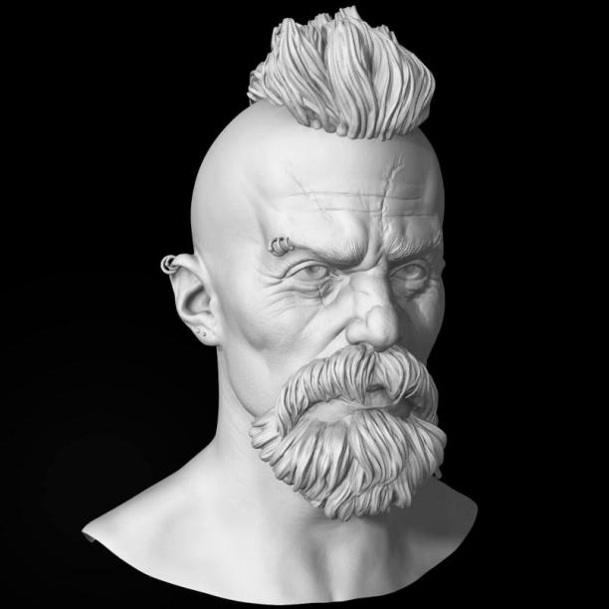
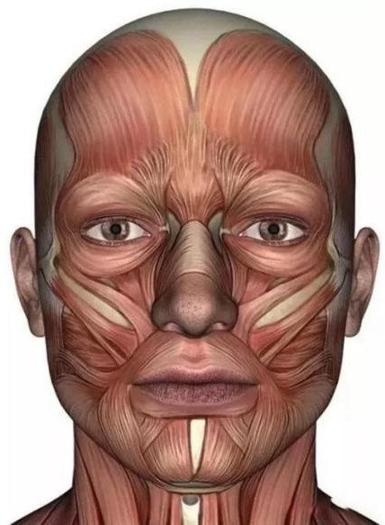
5
Figure 1
Figure 2

Slide 8
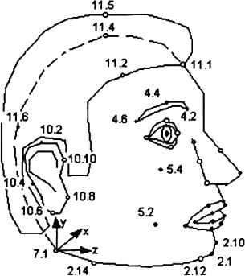
6
Preparation Process of Face Model Based on Computer Graphics
A. Calibration Process of Feature Points In the animation industry, there are two types of parameters used to describe human faces: animation parameters and definition parameters. Before creating a face model, we must obtain the specific values of the defined parameters, which relies on the calibration process of feature points. Arabic numerals are used to denote the order of points, with the lowest value representing the first decimal place. The main calibration targets include the overall contour, face contour, eye contour, mouth contour, eyebrow contour, ear contour, and nose contour (as shown in Figure ).

Slide 9
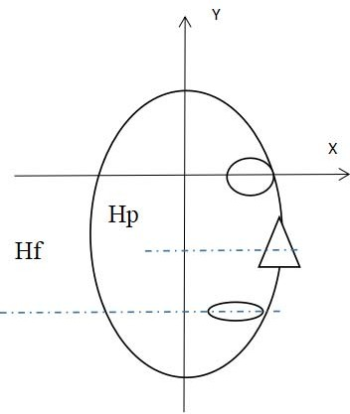
7
B. Normalization of Face Image The horizontal line of the eye center and the horizontal line of the mouth center serve as accurate reference axes for coordinate positioning. After establishing these coordinate axes, profile photos of the face can be normalized through coordinate transformations (as shown in Figure).

Slide 10
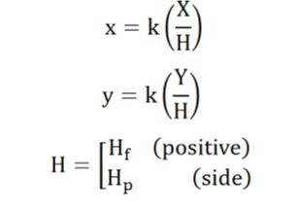

8
C. Color Characteristic Analysis The color characteristics of different faces vary. Research indicates that skin color can appear differently in various environments, though it tends to remain relatively stable. In this analysis, a Gaussian distribution model probability algorithm is used to calculate the distribution parameters. Afterward, an edge detection algorithm is employed to better determine the facial contours, facilitating stable face region localization. The Sobel algorithm will be utilized for edge detection. However, since the computer’s image processing function is limited to binarization, pixel value determination requires the extraction of two thresholds.
Formulae 1 :-
Formulae 2:-

Slide 11
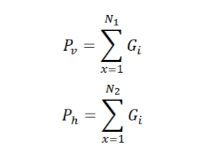
9
D. Determination of Animation Face Area Localization of the animation face region aims to define the basic boundaries of the face, avoiding overlap with the background. This process will involve calculating the vertical and horizontal directions using gray-scale integral projection.

Slide 12
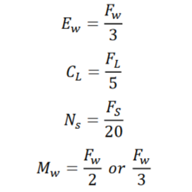
10
E. The Best Proportion of Facial Organ Area The placement area of the eyebrows is positioned at the midpoint between the hairline and nose, while the nose is centered on the face. The lips are placed at the second bisector between the nose and chin, and the eyes are positioned at the vertical bisector between the hairline and mouth. The width of the eyes generally accounts for three-thirds of the face width, and the length of the chin is typically five-thirds the length of the face. The surface area of the nose comprises up to 5% of the total facial area. For men, the mouth width is generally half the face width, while for women, it also typically measures half the width of the face.

Slide 13

11
Feature Extraction Algorithm of Animation Face Model Based on Computer Image Processing Technology
A. Eye Boundary Feature Extraction In two-dimensional images, the characteristic shape of animated characters' eyes resembles a parabola. The least squares method can be utilized to fit a curve and obtain the equation describing the eye boundary:

Slide 14
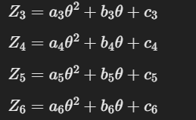
12
B. Mouth Boundary Feature Extraction Similar to eye boundary extraction, the least squares method can also simulate the mouth's parabolic shape. However, mouth boundary segmentation requires fitting four parabolas:

Slide 15
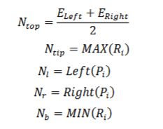
13
C. Feature Extraction of Nose Region The nose region has a complex structure, leading to uneven changes in the Gauss map across different areas. This variability makes it challenging for a single fitting curve to encompass the entire region. Therefore, distinct calculation formulas must be employed for different parts of the nose, covering key areas such as the upper edge, tip, left edge, right edge, and lower edge of the nose.

Slide 16
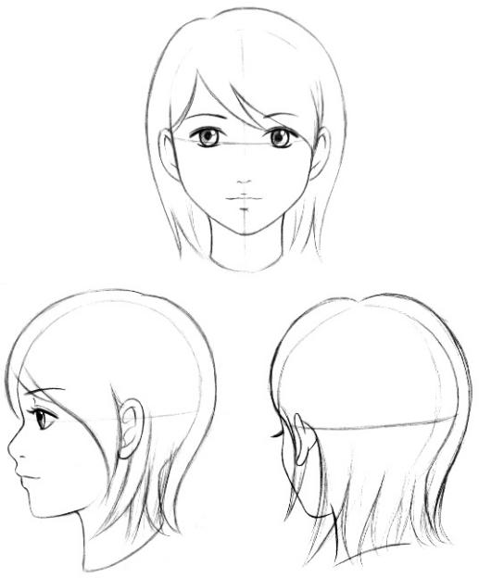
14
The final process of 3D animation face modeling based on computer graphics and image processing technology
Fabrication of two-dimensional model
The final process of creating a 3D animated face starts by first making a simple 2D drawing of the character. This involves carefully studying the character’s face, including key features like the eyes, nose, and mouth. Based on this, a basic 2D image is created. If the face is easy to draw, a single picture from the front is enough. But if the face is more complicated, you’ll need to draw it from different angles, like the front, side, and top views. This helps in ensuring the 3D model looks accurate when you move to the next step.

Slide 17
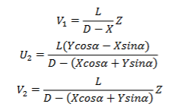

15
B. Extracting information from two-dimensional pictures using three-dimensional software
Extracting 3D information from 2D images falls under computer image processing technology, specifically focusing on machine vision to create a 3D representation of the human face. In this process, the virtual camera method is used. This method involves using two virtual cameras to "capture" the 2D image from different angles. Based on the images taken from these perspectives, an algorithm is applied to calculate the 3D information. This approach allows computers to generate a 3D sense of depth and shape from flat, 2D images.
D refers to the shooting distance of the camera, l refers to the focal length of the camera, and α refers to the rotation angle. The above three parameters can be set artificially. If the rotation angle is 90 degrees, the above formula can be expressed as:

Slide 18
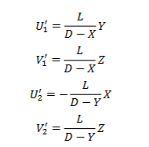
16

Slide 19
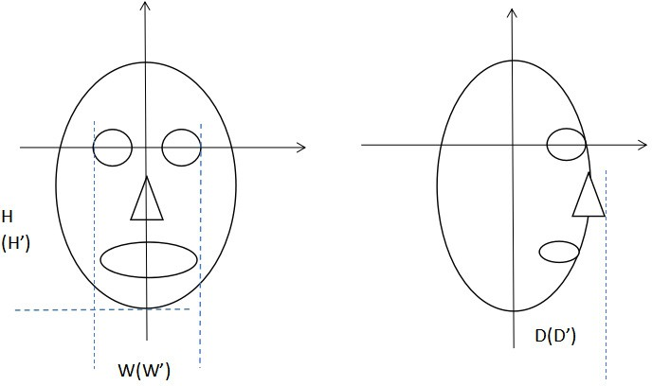
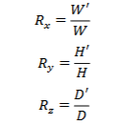
17
C. Overall deformation of animation face
Global deformation refers to changing the size of a 3D model by expanding or contracting it along the three coordinate axes (X, Y, and Z). This process is also known as scaling up or scaling down the model. After converting a 2D graphic into a 3D model, the following coordinate transformation algorithm is used to adjust the size of the model.
After a specific stretching ratio is adopted, the above formula can be rewritten as follows:

Slide 20


18

Slide 21
19
D. Final model design
Through the calculation of different algorithms, the face area of animation characters is evenly divided, and the proportion of five organs can be determined. The basic two-dimensional graphics can be made in the form of fitting curve, and then the three-dimensional model can be created according to the steps of virtual camera method.

Slide 22
20
Summary
This paper discusses how computer graphics and image processing technology can be used to create 2D images of animated characters. By analyzing the features and extracting key data, the face's proportions and the placement of facial features can be determined accurately. Methods like the least square method and 3D production techniques are essential for achieving this. However, there are clear limitations in this experiment. The algorithm used is more theoretical, and its performance in real-world applications isn't ideal. Additionally, the character models designed are static, meaning they don't perform well in dynamic environments or animations. Moving forward, specific improvements need to be developed to address these issues and enhance the design process for computer-generated animation models. This will lead to better outcomes in both the modeling and animation stages.

Slide 23
21
References
Research Paper Link :- https://ieeexplore-ieee-org.library.somaiya.edu/document/10062600
https://www.youtube.com/watch?v=2tXOxlnWgUM
https://en.wikipedia.org/wiki/Digital_image_processing

